Slide 1

Week 5 tutorial Exploratory data analysis & visualisations
2024/25 s2

Slide 2
Announcement
2024/25 s2
If you failed any of the assignments, resit will be held:
Monday March 10th at 15:00 in C1.05
• If you need extra help, there is a catch-up session on Wednesday March 12th 15:00-16:00
To sign up, go to Canvas, People section (and drag yourself over) Announcements

Slide 3
Today
2024/25 s2
Weekly knowledge questions & Q&A
Python tips & Warm-up exercise review
Weekly Challenge

Slide 4
Weekly knowledge questions
2024/25 s2
On Canvas
Quizzes → Knowledge questions week 5
Access code: QzW5
5 minutes, 6 questions

Slide 5
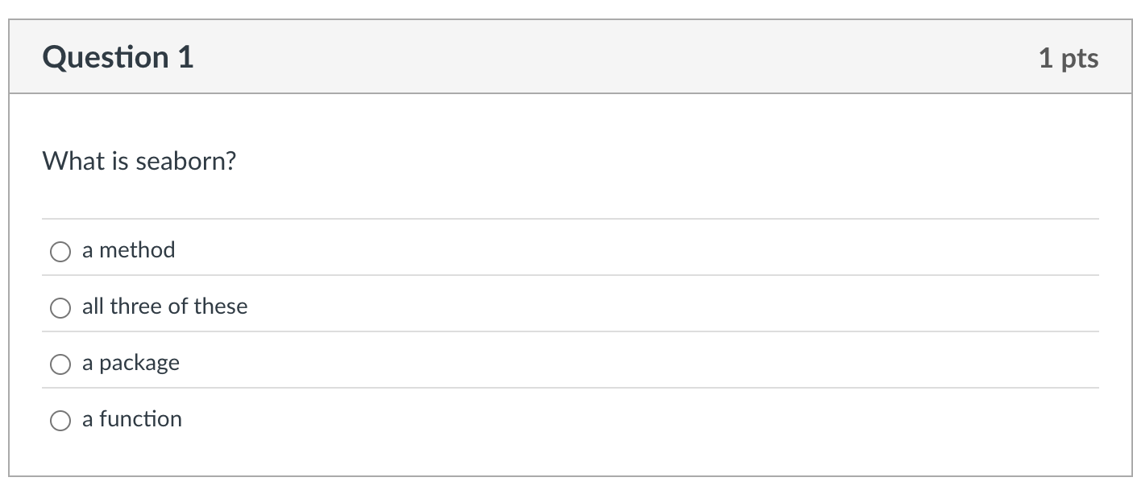
Q1 – What is seaborn?
2024/25 s2

Slide 6
Q1 – What is seaborn?
2024/25 s2
It is a package. Of course it provides functions and classes (which come with methods), but it is a package.

Slide 7
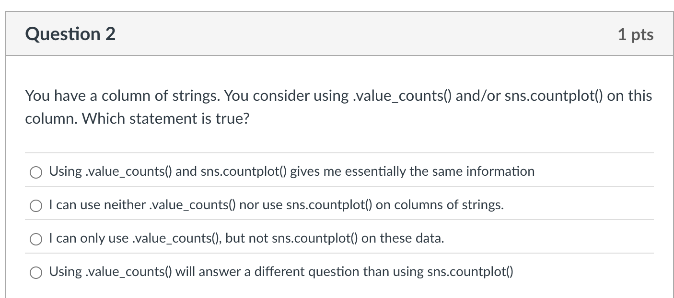
Q2 – You have a column of strings. You consider using .value_counts() and/or sns.countplot() on this column. Which statement is true?
2024/25 s2

Slide 8
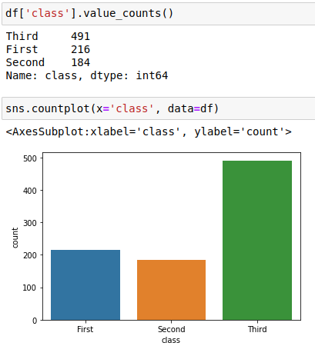
2024/25 s2
Using .value_counts() and sns.countplot() gives me essentially the same information

Slide 9
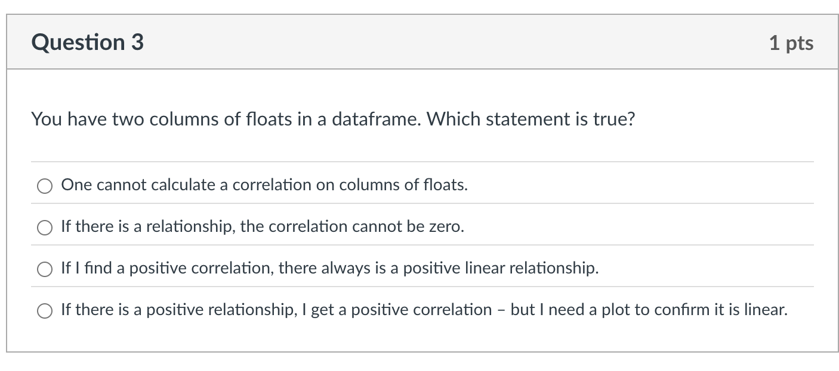
2024/25 s2

Slide 10
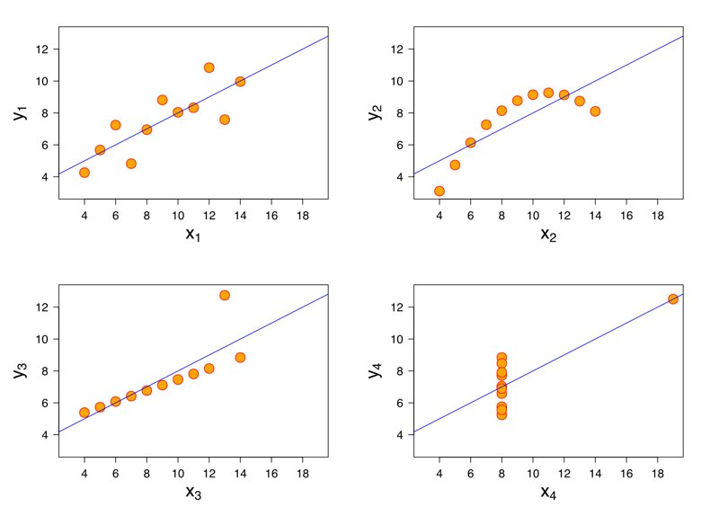
Q3 – You have two columns of floats in a dataframe. Which statement is true?
2024/25 s2
If there is a linear relationship, I get a positive correlation – but I need a plot to confirm it is linear.

Slide 11
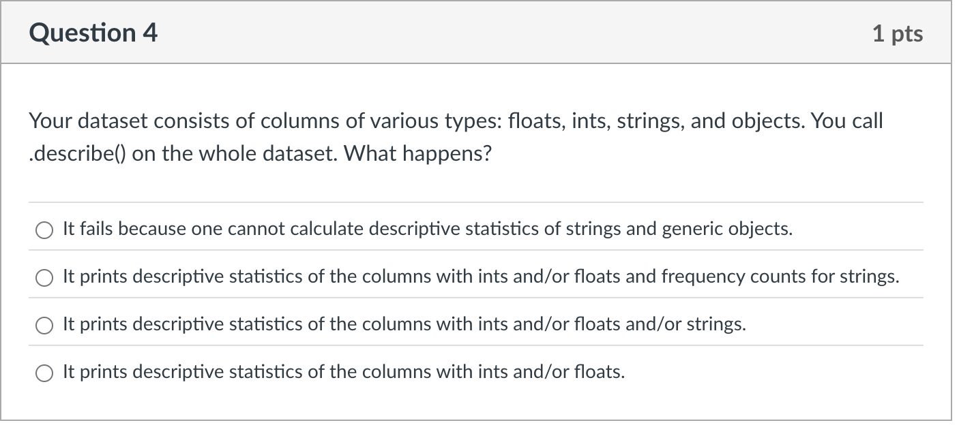
2024/25 s2

Slide 12
Q4 – Your dataset consists of columns of variuos types: floats, ints, strings, and objects. You call .describe() on the whole dataset. What happens?
2024/25 s2
It prints descriptive statistics of the columns with ints and/or floats
(pandas is smart enough for that, we saw that many times)

Slide 13
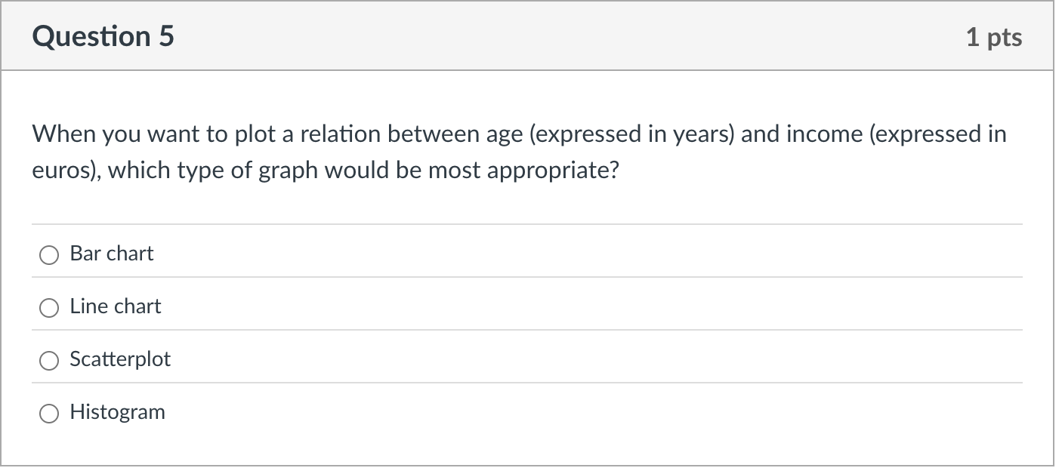
2024/25 s2

Slide 14
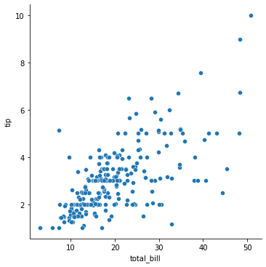
Q5 – When you want to plot a relation between age (expressed in years) and income (expressed in euros), which type of graph would be most appropriate?
2024/25 s2
A scatterplot (because both are continous)

Slide 15
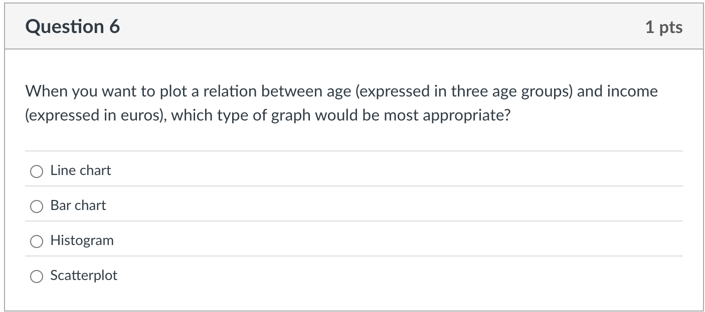
2024/25 s2

Slide 16
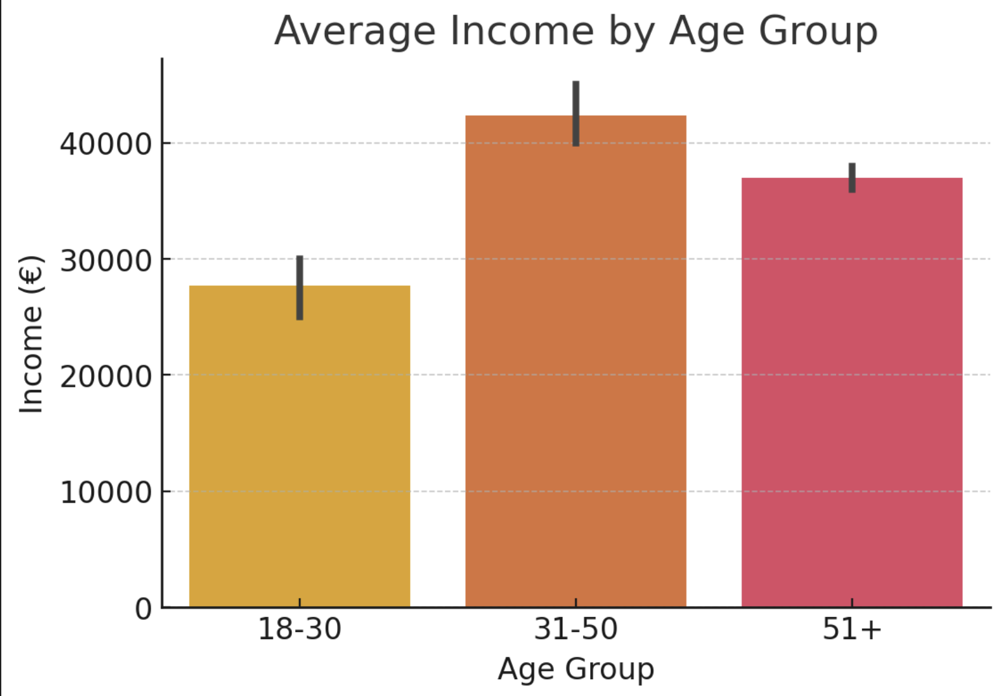
Q6 – When you want to plot a relation between age (expressed in three age groups) and income (expressed in euros), which type of graph would be most appropriate?
2024/25 s2
A bar chart
(because both age groups are not continuous)
Not in the response: a boxplot

Slide 17
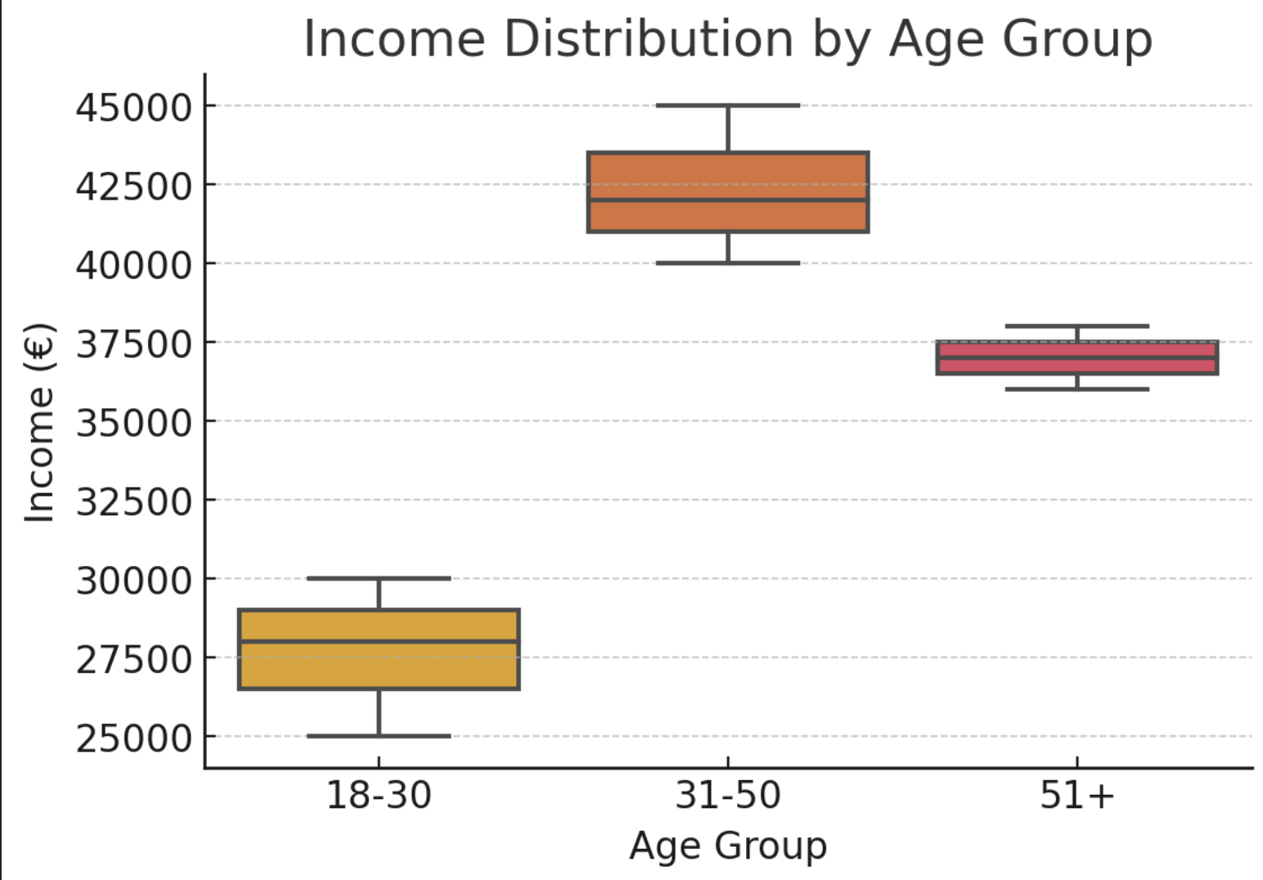
Q6 – When you want to plot a relation between age (expressed in three age groups) and income (expressed in euros), which type of graph would be most appropriate?
2024/25 s2
A bar chart
(because both age groups are not continuous)
Not in the response: a boxplot

Slide 18
Python tips I
2024/25 s2
Two approaches to merging with different column names:
Renaming columns first:
df2.rename(columns={"oldid": "correctid"})
Specify identifier columns in merge
df1.merge(df2, left_on="correctid_id", right_on="oldid", how="left")

Slide 19
Python tips II
2024/25 s2
Make sure you have the necessary packages installed
In jupyter lab:
Mac → !pip install matplotlib seaborn scipy
Windows → !conda install matplotlib seaborn scipy
If this doesn't work try: import sys
!{sys.executable} -m pip install seaborn --user

Slide 20
Warm-up Review
2024/25 s2
How did it go?
Who wants to share their solutions?
https://pad.carpentries.org/ccs1-2025-group2

Slide 21
Steps in working with your data in pandas
2024/25 s2
Loading data: check columns, data types, missing values
df.info() # Check structure, dtypes etc.
df.isna().sum() # Check missing values
Data cleaning and preparation: selecting relevant columns, merging (if necessary), dealing with missing data (if necessary), preparing variables
df = df[["col1", "col2", "col3"]] # Select columns
df.fillna(0, inplace=True) # Handle missing values
df = df.merge(df2, on="id", how="left") # Merge if needed
df["new_var"] = df["col1"] * 2 # Create variable

Slide 22
Steps in working with your data in pandas
2024/25 s2
Data exploration: descriptive statistics for relevant variables, crosstabs
df.describe() # Summary stats
pd.crosstab(df["col1"], df["col2"]) # Crosstab
df["col3"].value_counts() # Frequency
Data visualization: univariate and bivariate visualizations of relevant variables
sns.countplot(x="col1", data=df) # Univariate
sns.barplot(x="col1", y="col2", data=df) # Bivariate
Data analysis/modelling <- t-tests / linear regression NOT YET

Slide 23
Steps to choosing the correct statistical test
2024/25 s2
Identify the IV and DV
2. Identify the measurement levels of IV and DV
3. Identify the correct test…
IV categorical, DV continuous
→ Independent samples t-test (bonus: check the Levene’s test!)
IV continuous, DV continuous
→ Correlations

Slide 24
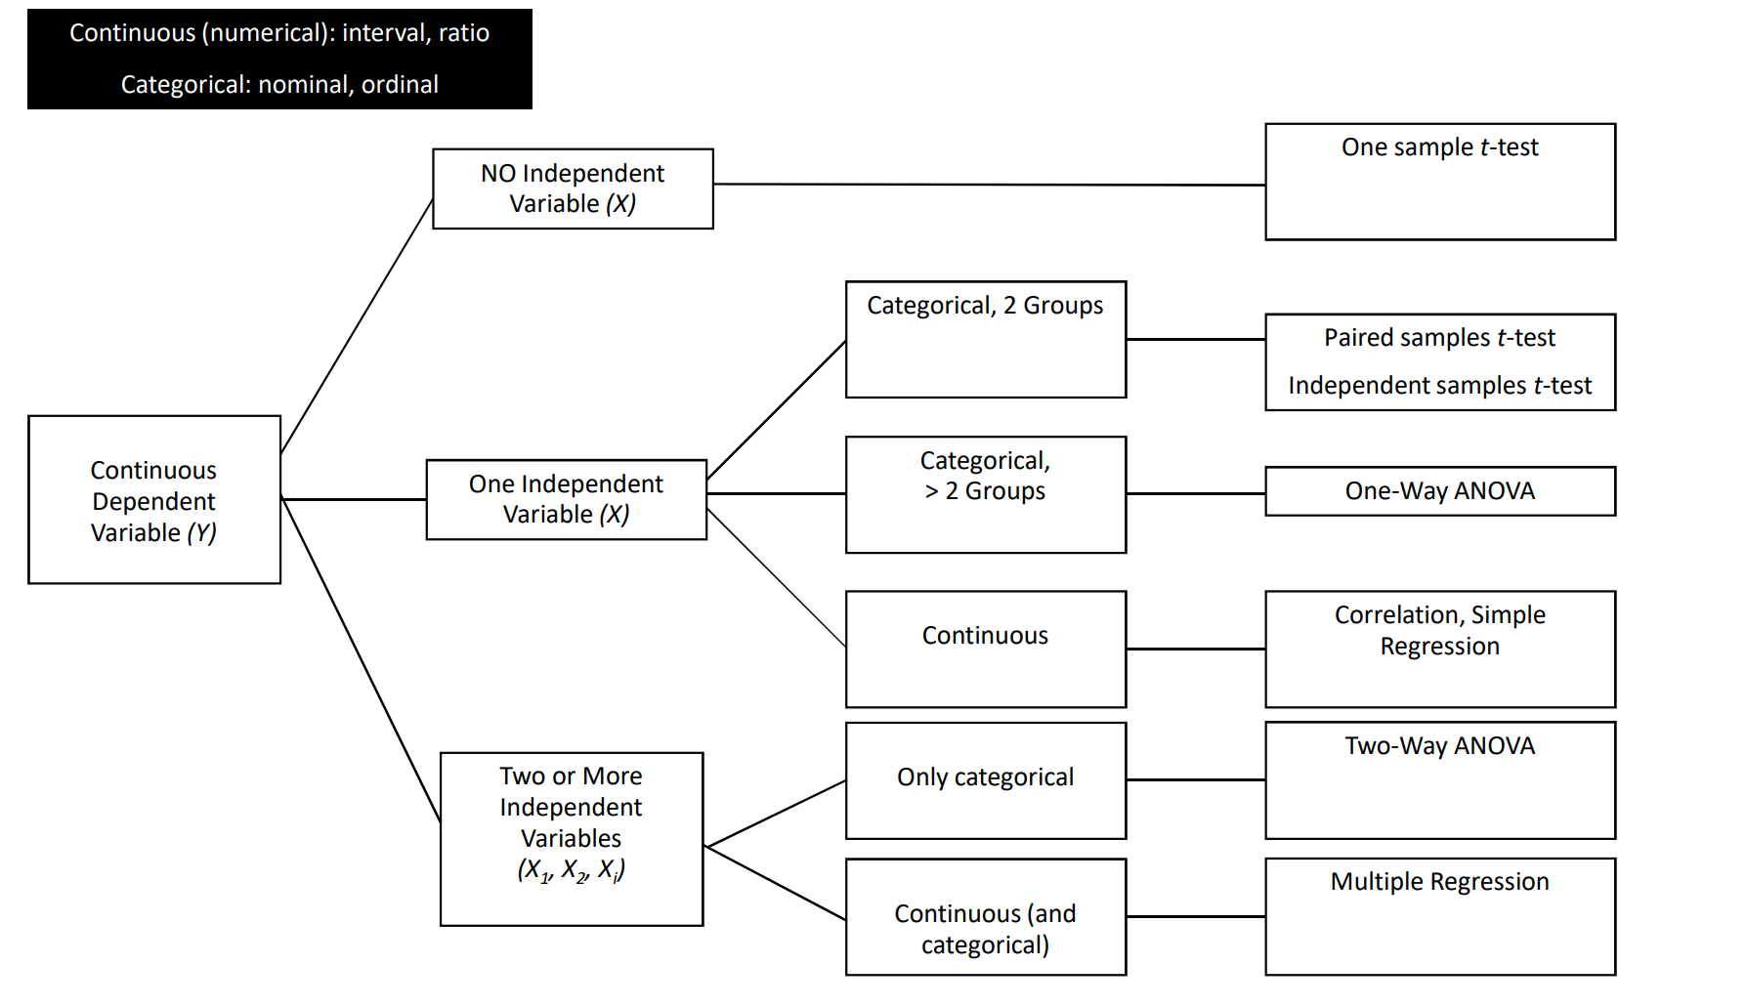
How to choose a statistical test?
2024/25 s2
Notes:
We have showed then correlations, independent sample t-test, anovas (including interaction and convariates) and regression

Slide 25
Weekly challenges
2024/25 s2
Find your pair
Program
Have the lecture notebooks open while you work! Especially visualizations.ipynb will help!
Ask me anything!

Slide 26
Next steps
2024/25 s2
Week 6
Complete required readings before lecture
Review pandas and visualizations– we will have final in-class assignment (no code review or MC questions)
We will learn about working with texts and images!

